Slide 1
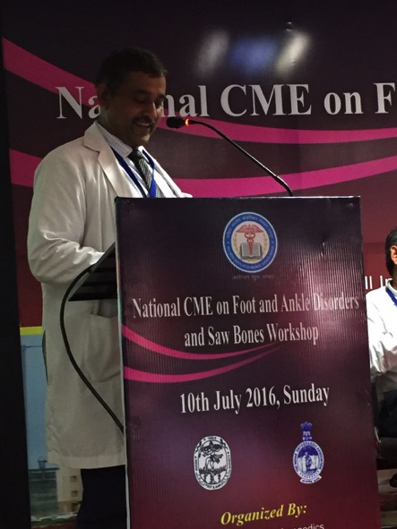
National CME on Foot and ankle disorders
AIIMS Raipur CG
10-7-2016
Course Director: Prof. Dr. Alok Chandra Agrawal

Slide 69
Thank you

